Slide 1
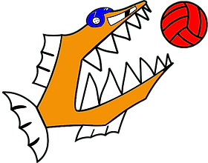
Water polo 101
the rules and how to play

Slide 2
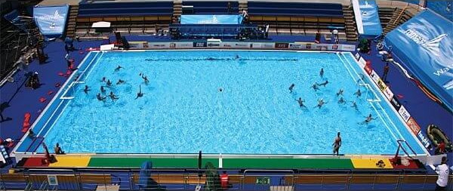
The rules (basics)
Water polo is played in the pool (obviously) which should be at least 25m long and 1,8m deep
Men's competitions play with a WP5 ball, which is roughly the same size as a football. The women’s play with a WP4, which is a bit smaller and less heavy.
Teams consist of 7 players, 6 field players and one goalie.
Substitutions are unlimited but can only be done in certain areas and times during the match.
A match has 4 periods of 5 up till 8 minutes, depending on the level you play at.
Play time in water polo is exact, so when the referee stops the game, the time is also stopped.
Notes:
5 minutes for Guppies and Gents 2, 7 minutes for gents 1

Slide 3
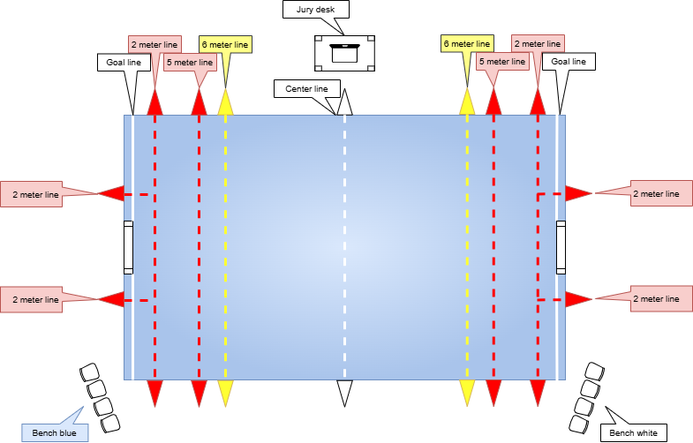
The rules (field)

Slide 4
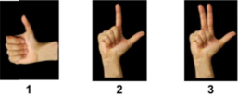
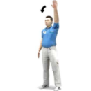
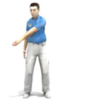
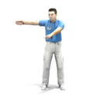
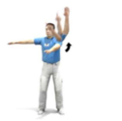
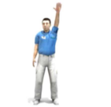
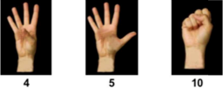
The rules (Referee and jury)
The referee is in charge of the match and, unlike in football, complaining or criticising the ref is hardly tolerated.
The jury is in responsible for using the clocks, keeping score and filling in the match form. They are usually provided by the home playing team.
Depending on the level you play, there are either one or two referees present.
Next to their whistle, referee(s) uses hand signals to communicate to the players and jury. Common to see hand signals are:
Source: KNZB Waterpolo spelregels 2023 Bijlage 5, art. 8 https://np-knzb-corporate-production.s3-eu-west-1.amazonaws.com/Bestanden-en-Formulieren/Spelregels-2023-V3.1-DEF.pdf

Slide 5
The rules (Offense and scoring)
You score points by throwing the ball in the opponents goal.
A team has a set amount of time to play an attack. This is called the shot clock. The shot clock starts when the offensive team gains ball control. Then they have 30 seconds to try to score.
If a shot is fired and the offensive team keeps ball control, the shot clock resets to 20 seconds. If the defensive team gains the ball, they start again with 30 seconds to attack.
Every quarter starts with a swim off. Both teams line up at their side of the pool and when the referee blows his whistle, you can start swimming. The referee will place the ball on the centre line by the side of the pool. The team which gets the ball first, has the first attack.
After each goal, both teams go back to their own half of the pool before starting again

Slide 6
The rules (Fouls I)
Water polo is a semi-contact sport, which means some physical contact is allowed but definitely not everything.
There are 2 kinds of fouls in water polo: ordinary and major, depending on the severity of the foul.
After an ordinary foul, the play does not stop and only the clocks (shot and game) stop momentarily until the offended player takes his free throw.
When the offended team is awarded a free throw, they must take it in the position where the ball is at that moment. They must put the ball in play without delay by passing it, swimming with it or shooting it (if outside of 6-meter line). Fake shots or just holding the ball are not allowed.
For major fouls, there can be 4 different kinds of punishment. The personal foul (P or U20), the penalty (S), the exclusion with substitution after 20 seconds (UMV) and the exclusion with substitution after 4 minutes (UMV/4).

Slide 7
The rules (Fouls II)
When a player gets a personal foul, is send out for 20 seconds. During the period, their team is a man down. And the guilty player must swim as quick as possible to the corner of the pool in front of there own substitute bench, without hindering the game. After 20 seconds, a flag (white for home team and blue for away team) is waved by the jury and the player can re-join. If the offending team gains ball control within 20 seconds, the player also can re-join (after a signal from the referee).
When a team gets a penalty, 1 player can shoot the ball at the opponents goal from the 5-meter line without being hindered by other field players and the goalie restricted to lay on the goal line. After the whistle of referee, the player must shoot without delay or interruption.
When a foul is deemed brutal by the ref, the offending player will get an exclusion foul. This means the player will have to leave the swimming hall completely and there will be a case against him at the disciplinary committee for the KNZB. The player can be substituted after either 20 seconds or 4 minutes of play, depending on the severity of the foul. An exclusion foul can be followed by a penalty for the offended team.

Slide 8
The rules (Fouls III)
Some examples of the different types of fouls can be found below:
Ordinary fouls | Personal fouls
Touching the ball with two hands | Impeding a player who makes an action towards the goal
Taking the ball under water | Interfering with a free throw
Holding or pushing a player who is not in possession | Aggressively holding or pushing a player not in possession
Pushing off of a player | Using two hands to hold an opponent
Stalling (e.g. not shooting withing shot clock) | Splashing water at an opponent
Penalty fouls | Exclusion fouls
Goalie taking the ball underwater | Kicking, striking, elbowing or other physical violence
Excluded player re-joins wrong or to early | Disrespecting an official
Impeding a attacker in control of the ball, who has passed the last defender. | Committing an act of misconduct by using foul language or violent or persistent foul play
Blocking a shot with 2 hands (when not the goalie)

Slide 9
The game (Offensive & defensive positions)

Slide 10
The game (Man up & man down positions)

Slide 11
The game (tips & tricks)
Play as a team, you’re limited in the amount of players you have so use them all.
Make sure some is expecting a pass by making eye contact.
Try to be available for team mates to receive passes from.
Don’t be afraid to take a shot when you have an opportunity.
Try to get to your positions quick but don’t forget to go get the ball.
Keep you head above the water.

Slide 12
Questions?
Water polo 101

